Slide 1
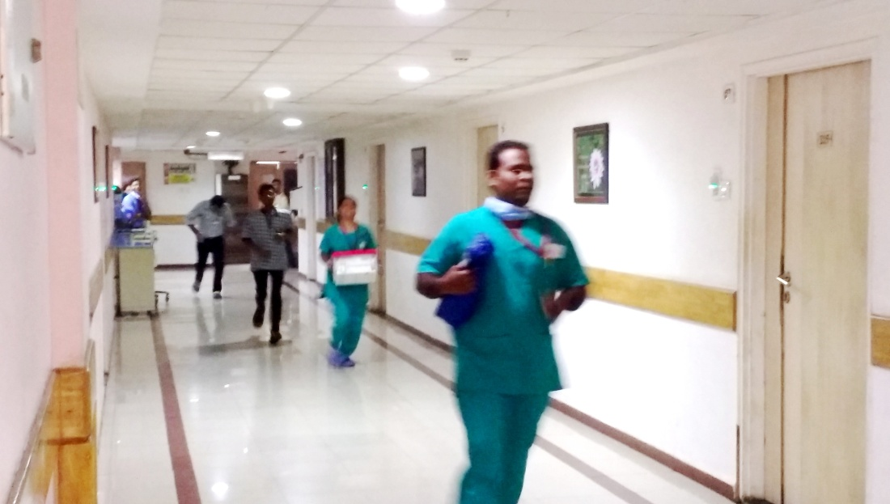
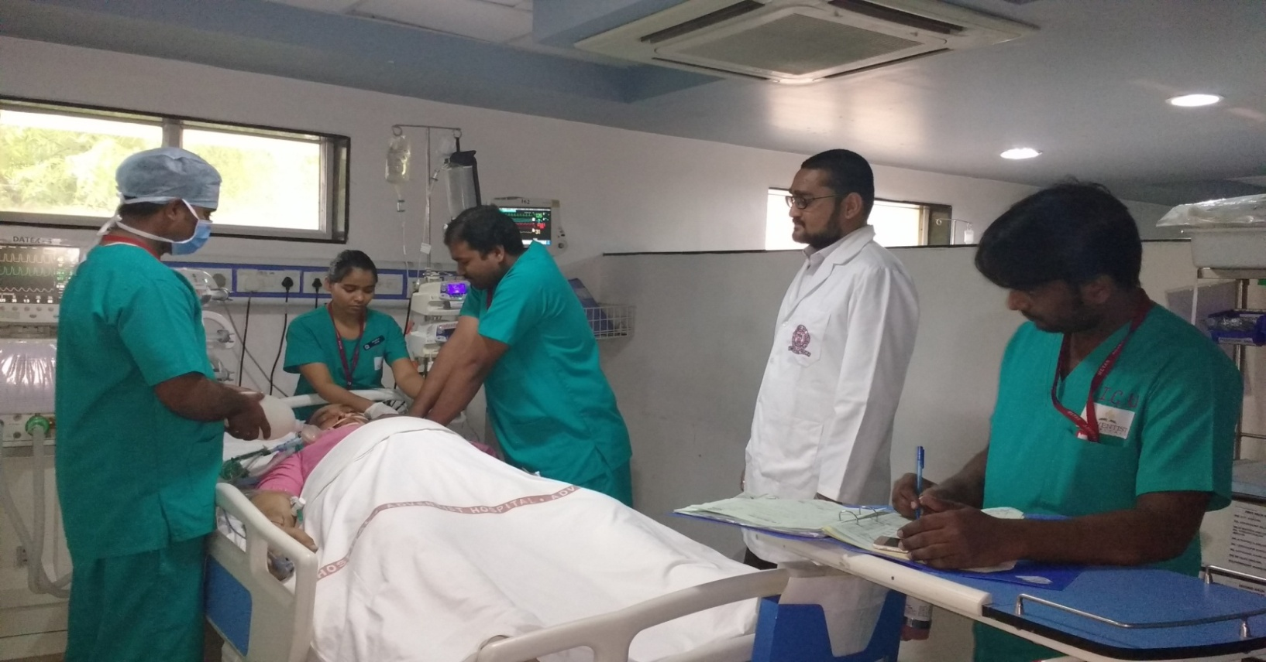
Metas Adventist Hospital, (INDIA) Southern Asia Division Dr. Anil Kumar Chillimuntha Athwalines PO Box no.24, Surat, Gujarat India / anilch122003@yahoo.com
Quality Improvement Project
A Journey towards decreasing Incidences of Code Blue in the Hospital
Introduction
Activities / Highlights
Code Blue is a hospital emergency code to alert health care professionals about a patient requiring immediate resuscitation or medical attention, which is often due to respiratory or cardiac arrest. This is an effective measure practised in hospitals to revive patients. A Code Blue Team, which is headed by an Intensivist, takes the responsibility of resuscitating patients.
A Descriptive study was done between Jan 2017 to Sept 2018. Gaps in resuscitative measures were identified and strategies were initiated to have positive outcomes of patients after a Code Blue.
Graphical presentation of decreasing trend in number of Code Blues.
History
Patient death due to cardiac or respiratory arrest are common in hospitals. Globally about 200,000 to 750,000 cardiac arrests occur annually among hospitalized patients. In Metas Adventist Hospital about 30-40% patients who are activated code blue die. Therefore Metas Adventist Hospital has taken initiative to study current resuscitative measures by formulating a Code Blue Team to identify gaps and to implement successful strategies to prevent patient death due to Code Blue.
Mission
1. To identify number of code blues in the years
2017 & 2018
2. To identify gaps in resuscitative measures
3 .To implement strategies to decrease the number of Code Blues
4. To Provide effective resuscitation measures
Statistical Summary of No. of Code Blues
 | No. of Code Blue | No. Of Intubations | No. of RRT | Patient Outcome
 |  |  |  | Revived | Deaths
Jan-March’17 | 22 | 22 | 15 | 12 | 10
April-June’17 | 16 | 16 | 28 | 8 | 8
July-Sept’17 | 10 | 10 | 32 | 4 | 6
Oct-Dec’17 | 14 | 14 | 35 | 8 | 6
Jan-March ‘18 | 21 | 21 | 30 | 13 | 8
April-June ‘18 | 19 | 19 | 28 | 12 | 7
July-Sept’18 | 11 | 11 | 3 4 | 7 | 4
Future Goals
In future, more studies will be conducted to further decrease the incidence of Code Blues. More classes and mock drills will be provided to our healthcare professionals to effectively improve resuscitation measures.

