Slide 1
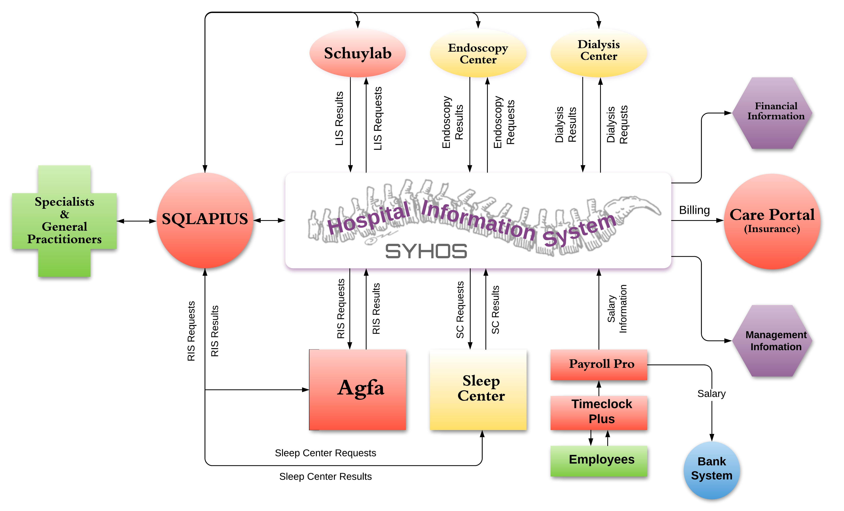
Antillean Adventist Hospital (AAH) (CURACAO) / Inter-American Division Cenaida Panneflek Groot Davelaarweg 1 / contact@aahospital.org
Leading The Way In Digital Health Care
Introduction
Activities / Highlights
The AAH is a short stay hospital that serves low risk and limited acute risk patients. With its team of 260 employees and 35 specialists it serves 35% of its community. AAH boasts an infection rate of less than 1%, a patient satisfaction rate of 96% and has the oldest fully vegetarian kitchen on the island.
History
From its start as a maternity clinic the hospital has steadily expanded its services and now provides general surgery, orthopedic surgery, gynecology, urology, plastic surgery,
ophthalmology, endoscopy, radiology and lab services, internal medicine and a sleep center.
Mission
Mission: To Reflect Christ
Vision: Respect patients and exceed expectations.
Values: HIReach (Humility, Integrity, Resilience, Enthusiasm, Accountability, Compassion and Hospitality)
Statistical Summary
Future Goals
Mortality 01 Market Share 35%
Transference 06 Occupancy 65%
Falls 02 Outpatients 42,100
Intra Hospital Infection 01 Inpatients 8,007
Complaints 08 Beds 100
Needle Stick Injury 02
Short term goals:
Construct 4 state of the art operating theatres
Complete our Dialysis Center
Employ qualified and dedicated personnel
Set up a pharmacy to serve external patients
Become an accredited JCI and ISO facility
Long term goals:
Reconstruct the facilities at both locations to avoid flooding in the future

