Slide 1
CAMEL
Wellness Panel
October 22, 2018

Slide 2
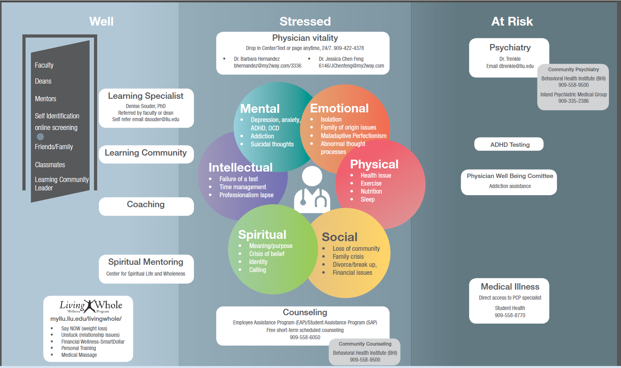
Dr. Darcy Trenkle
dtrenkle@lllu.edu

Slide 3
Religion/ Social Student Social VP Carla Gober | Resilience Barbara Hernandez Jessica Chen Feng | Learning Strategies Dr. Souder | Professionalism Dr. Loo and Dr. Oei | Service Learning JC Belliard/Dr. Baum
Welcome Picnic Aug 1, 6- pm | Resilience Skills Intro 2nd yrs only Aug 27,29 | Time Management and Study techniques 1st years only Sept 24, 26 | Professionalism Cases 2nd yrs only Oct 29, 31 | Intro to Social Determinants at Gateway 1st & 2nd yrs Oct 8,10
LC Leader Faith Story Date TBD in ORM Aug 8-Sept 12 | Getting Help with online screening 1st years only Nov 5, 7 | Advice from 2nd years/EBM strategies/time management 1st & 2nd yrs Nov 26, 28 | Professionalism Cases 1st years only Jan 7, 9 | Bias 1st years only April 15, 17
LC Dinner Date TBD Aug, Sept | Getting Help with online Screening 2nd yrs only Nov 12, 14 | Board Study Plans 2nd yrs only Jan 14, 16 | Professionalism Discussion (could be resilience?) 1st & 2nd yrs Feb 25, 27 | Reflection on Service Learning 1st years only May 20, 22
Social Competition 1st & 2nd yrs May 3 | Being a Whole person 1st years only April 1, 3 | Learning Strategies 1st years only Feb 11, 13

Slide 5
Student Vitality Task Force
Learning Community Director
Dean of Students
Another Learning Community Faculty rep
Religion curriculum rep
Physician Vitality Office rep
Mental Health (SAP/Psychiatry Rep)
Student reps
Learning Specialist
Curriculum committee rep
Service Learning rep
Basic Science Faculty
Clinical Science Faculty
Ethics Faculty

Slide 6
Dr. Darcy Trenkle
dtrenkle@lllu.edu

