Slide 1
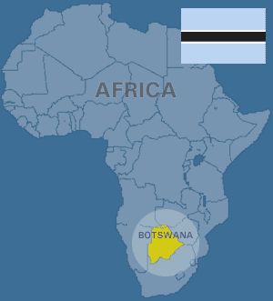
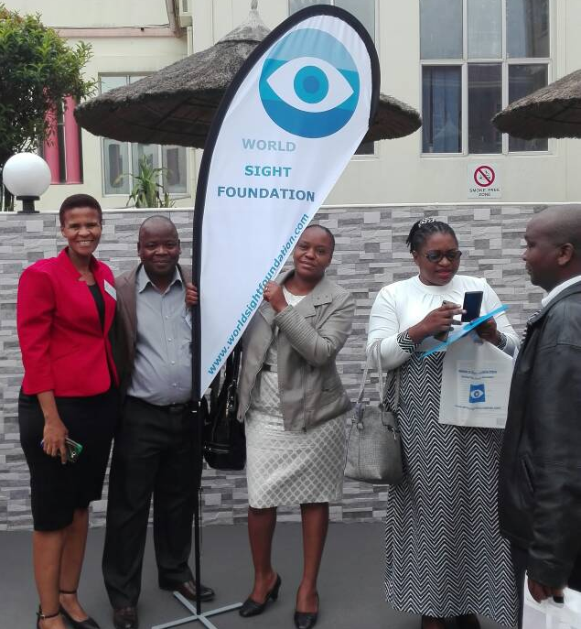
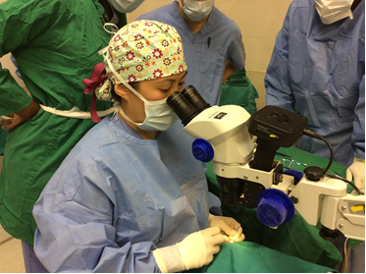
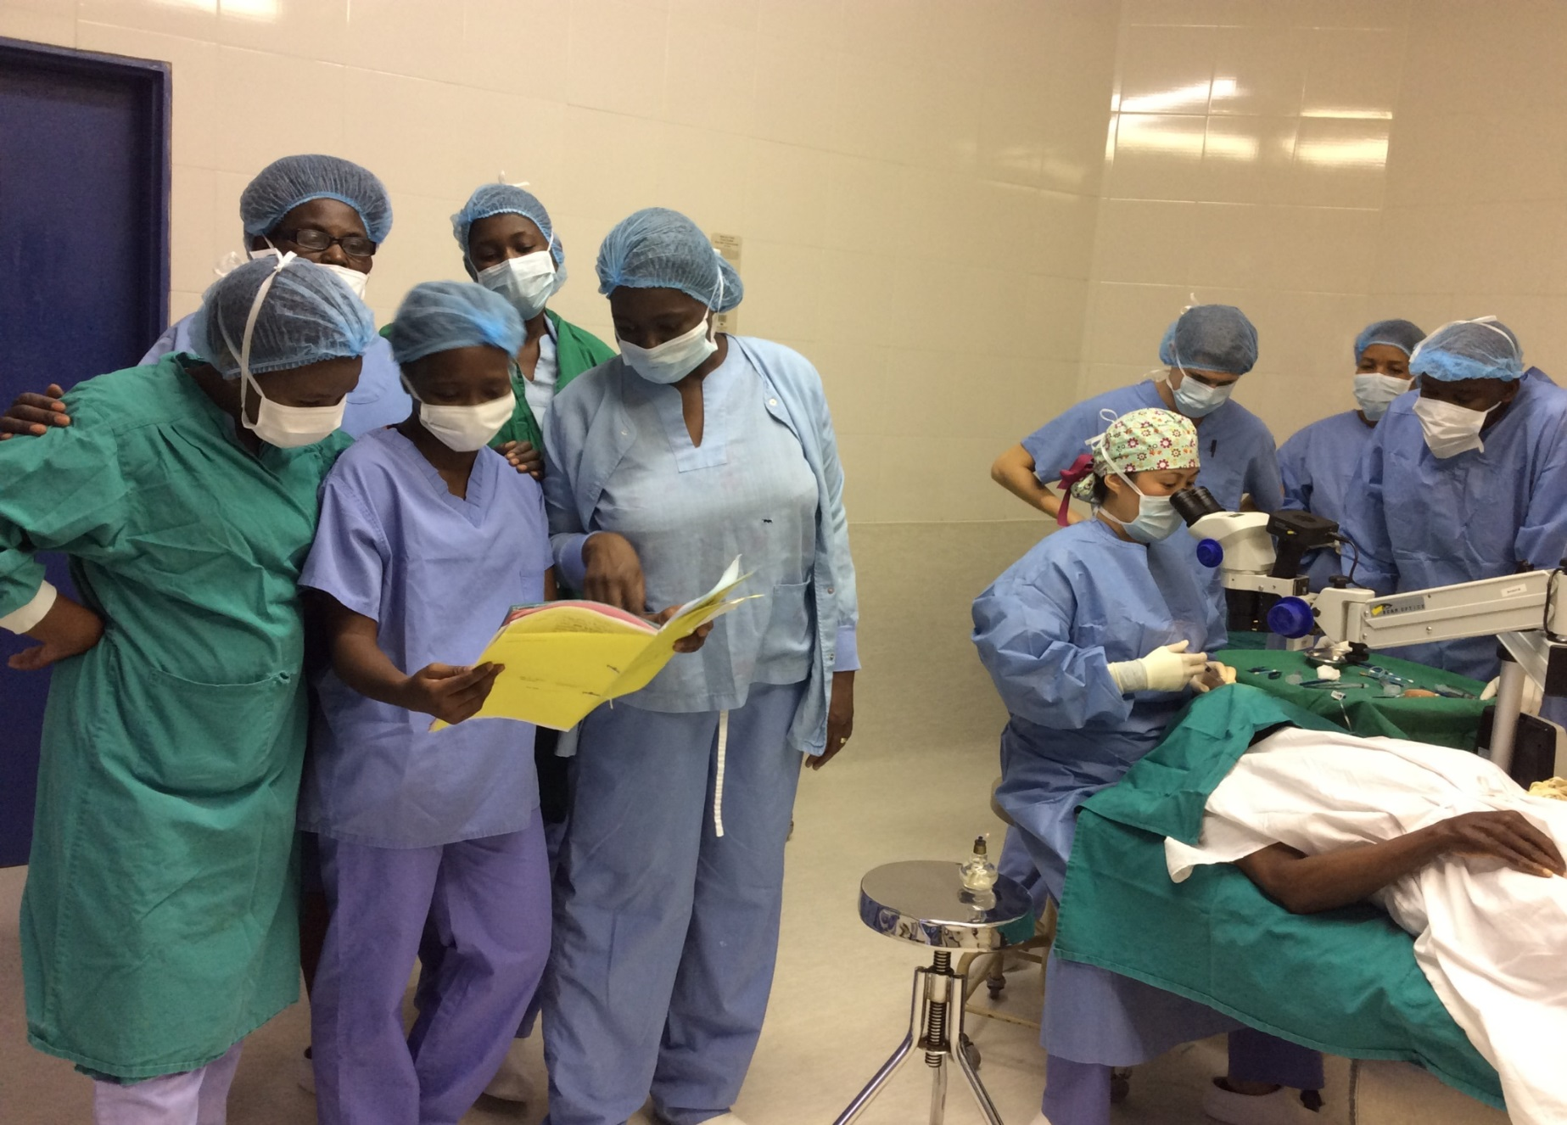
KANYE ADVENTIST HOSPITAL, BOTSWANA CATARACT REDUCTION CAMPAIGN Administrator: Hospital Superintendent: Dr. Brendan Jacob Tombs Project Leaders: Virginia Magwati & Ruth Mogwera (Ophthalmic Nurses) drtombsb@kanye.adventist.org
LEITLHO: SEIPONE SA LEFATSHE (THE EYE: THE WORLD’S MIRROR)
Introduction
Activities / Highlights
Kanye Adventist Hospital responds
to Vision 2020 strategies of reducing cataract blindness through surgeries thus fulfilling a Botswana government Vision 2016 Pillar of ”A compassionate, Just and Caring Nation” and a value of our institution “..but to minister”
As the nation celebrated 50 years of independence, Kanye Adventist Hospital, Botswana Union Conference, Lusaka Eye Hospital and Ministry Of Health & Wellness Botswana united to reduce cataract backlog.
Project planning: Started 2012 - 2013.
Implementation: 2014 to date.
Stakeholder involvement/participation: Continuous since 2012.
Pre-operative screening: Final selection process done two weeks before surgery.
Cataract Surgeries: Done for a period of five days annually.
Post-operative care: 8-12 weeks follow-up according to WHO standards.
ACHIEVEMENTS:
Reduction of cataract backlog by 80% in four years of project.
Cataract surgical waiting time reduced from five years to less than one year.
Wide cataract health promotion thereby increasing cataract uptake.
Project nomination for Ministry of Health and Wellness Convention in May 2018.
Department of Public Service Management project participation.
Awarded best project Kanye Adventist Hospital 2018..
Resulted in International recognition from World Sight Foundation which facilitated annual trainings of ophthalmic nurses nation wide in continuous professional development.
BOTSWANA OPTHALMIC NURSES ATTENDING TRAINNING IN DURBAN NOVEMBER 2017
Shortage Of Eye Personnel and Consumables.
Long Cataract Surgery Waiting Time (Backlog).
Complications Due to Cataract.
Eye Clinic Congestion
DRIVING FACTORS
Stakeholders who made the project a success… (Living the dream a proud and united nation)
Botswana Union Conference, Ministry Of Health & Wellness Botswana, Lusaka Eye Hospital, Kanye DHMT, Thamaga Primary Hospital, Scottish Livingstone Hospital, Mahalapye Hospital, Moshupa Adventist Clinic, and Moshupa DHMT.
BOTSWANA UNION
COFERENCE
ANNUAL CATARACT BACKLOG REDUCTION CAMPAIGNS
ANNUAL CATARACT BACKLOG REDUCTION CAMPAIGNS
CATARACT REDUCTION
History
In 2009 the country of Botswana experienced a huge backlog of patients awaiting cataract surgery due to a shortage of ophthalmologists. In 2013 Kanye Adventist Hospital and its catchment areas had approximately 700 patients waiting cataract surgery, with an average waiting time of five years. More than 50% of eye clinic attendances were cataract patients who were continuously frequenting the clinic in search of surgical interventions.
Mission
Sterility importance for good outcome of surgeries (nurses demonstrating autoclaving during campaign)
Kanye Adventist Eye Clinic promotes and provides quality ophthalmic services through preventative, curative and rehabilitative care.
Statistical Summary
Future Goals
To reduce magnitude of blindness in those awaiting cataract surgery in Kanye and its catchment areas through conducting annual cataract surgeries by the year 2020 and beyond.
To network with international community in prevention of blindness.
To minister the gospel through the ministry of healing.

