Slide 1
Training Guide: Loma Linda University Health’s Learning Management System (LMS)
Updated 01-23-22

Slide 2
The new Learning Management System (LMS) platform will allow you to:
See which courses are available and coming up
Register for courses
Access the course Zoom link to attend a class live or the link to watch the recording
Access course materials and content
Access the course post-test
Keep a record of courses you have taken and easy access to download certificates of participation for courses that you have completed

Slide 3
Content:
To access your Learning Management System (LSM) account – if you already have an account set up
To create a new account
To change the default language for your portal
For access on-the-go, download the Talent LMS app to your Smart Device
To view and register for courses
To access the Leadership homepage and register for courses directly from the website
How to access your TalentLMS Account to view registered courses, upload photo, download certificates, change user information, etc.

Slide 4
1. To access your Learning Management System (LMS) account – IF you already have an account set up
Note: An account has already been created for everyone who registered for Conversations on Governance

Slide 5
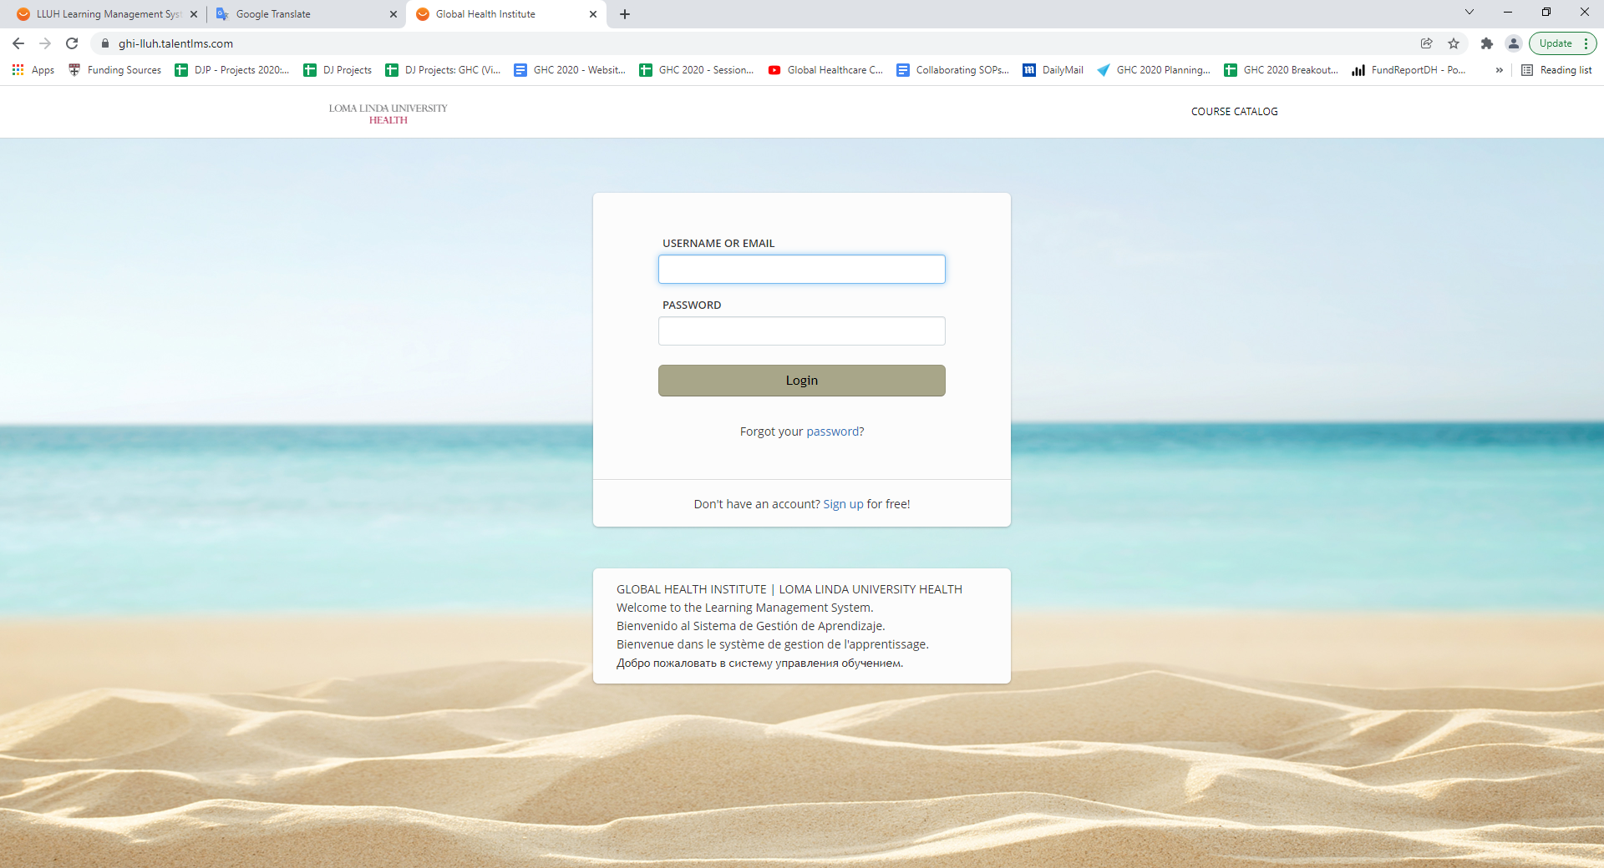
Go to: ghi-lluh.talentlms.com

Slide 6
Note: An account has already been created for everyone who registered for Conversations on Governance Click Forgot Your Password

Slide 7
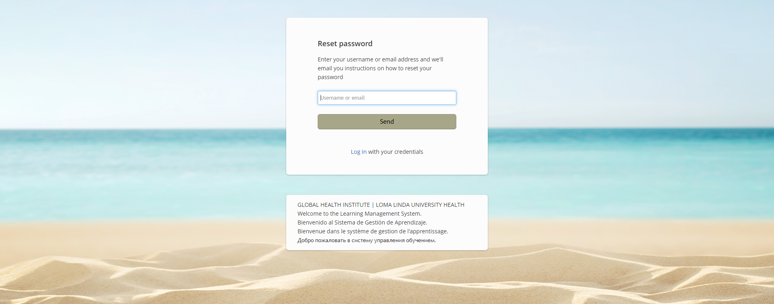
Enter your email address and hit “Send”

Slide 8
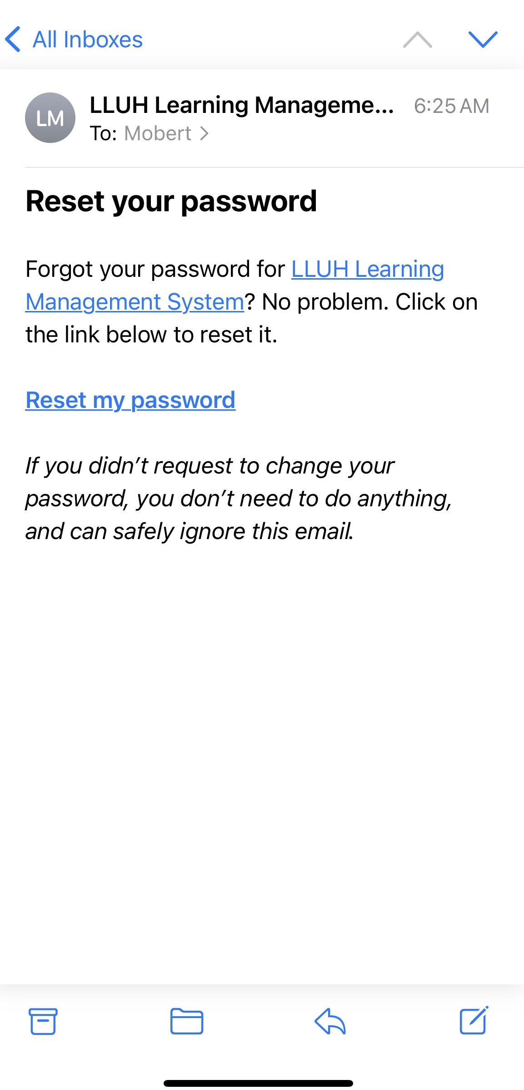
Go to your email account and follow the link to set a new password

Slide 9
Go to ghi-lluh.talentlms.com and enter your email and password

Slide 10
2. To create a new account
Note: If you already have an account created under your email address, you will not be allowed to set up a new account.
Please go back to ghi-lluh.talentlms.com and select “Forgot Password” to reset your password.
Please DO NOT create a new account with another email address.
You should only have ONE account in the system.

Slide 11
Go to: ghi-lluh.talentlms.com

Slide 12
Click on “Sign Up for Free”

Slide 13
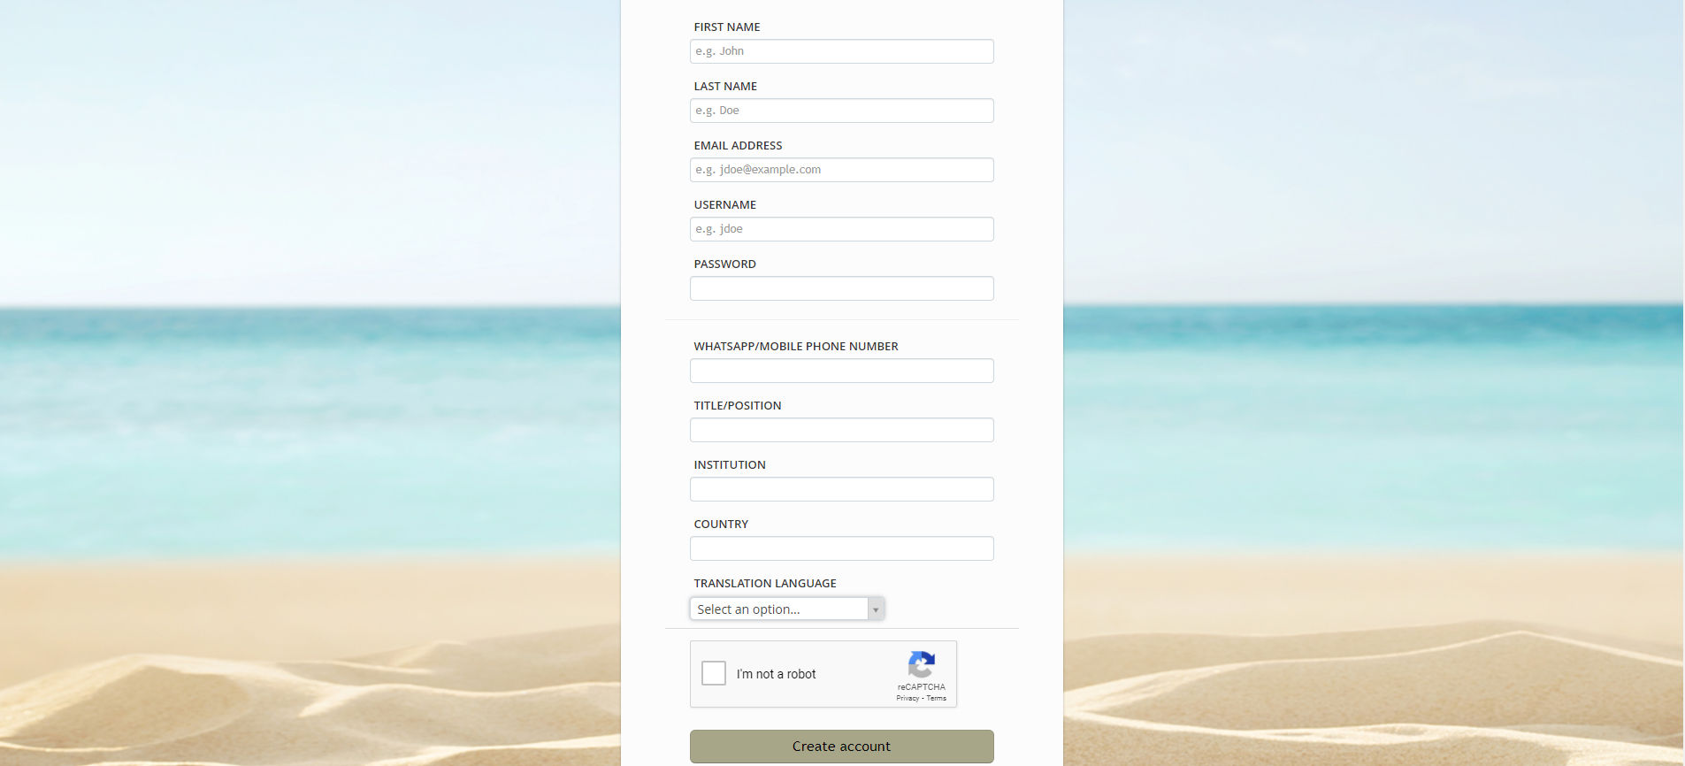
Complete ALL of the fields and click on “Create account”

Slide 14
3. To change the default language for your portal
It is important to set your language in your account for how you view the portal, so that the buttons and fields are in your language.

Slide 15
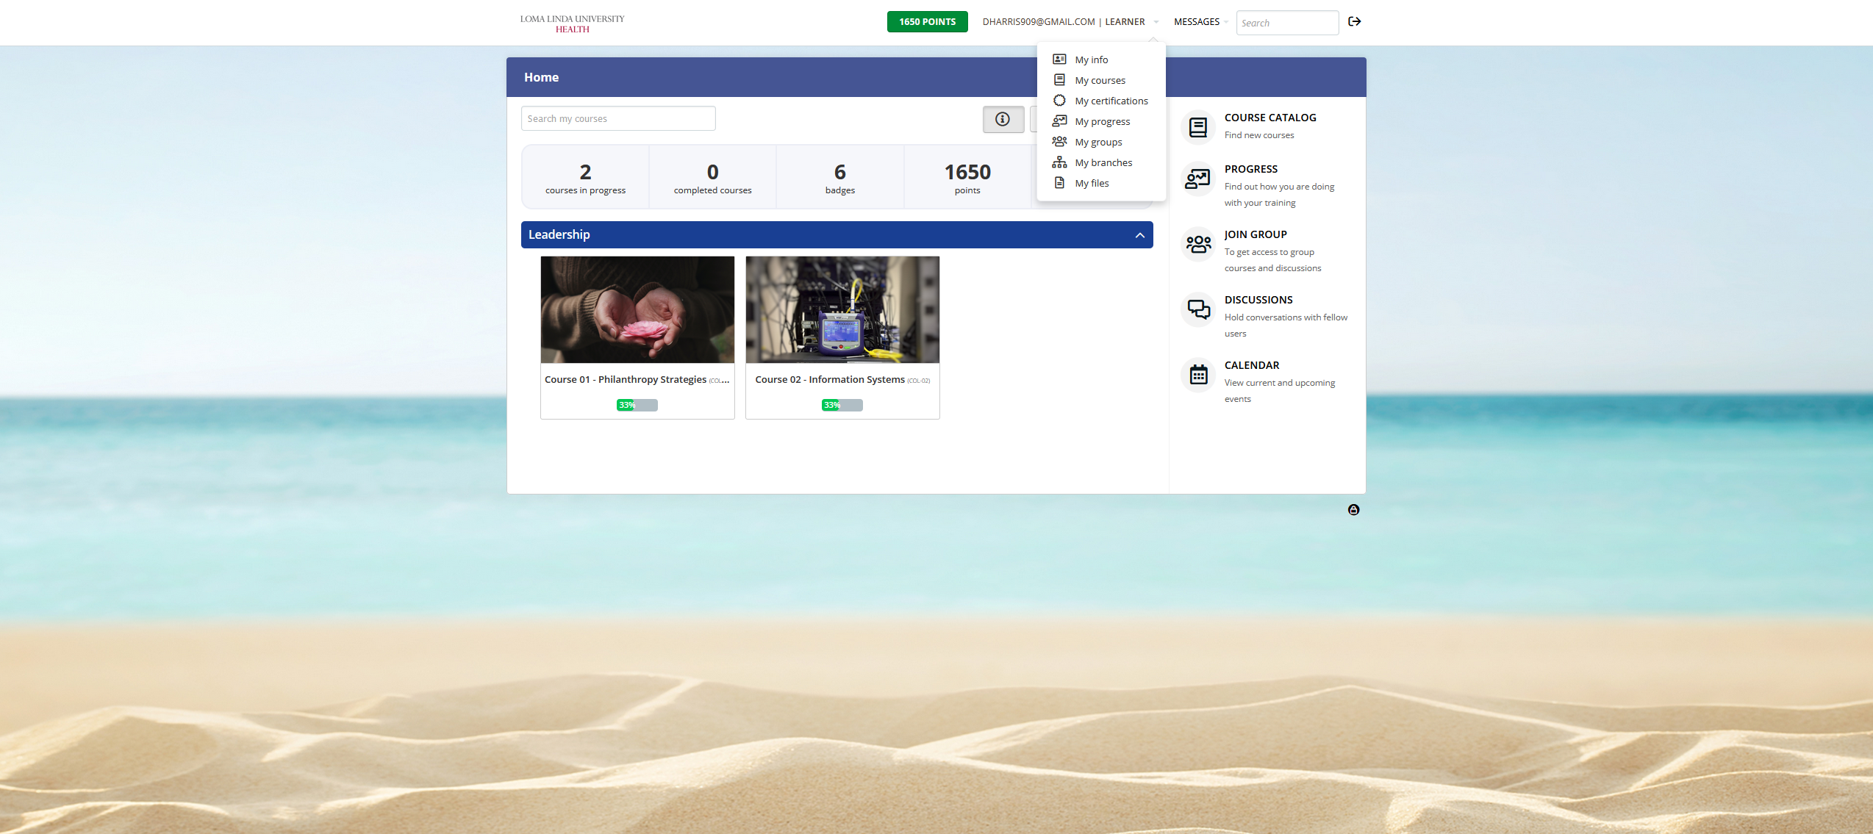
Go to the “info” tab of your Account. Click on your email address at the top.

Slide 16
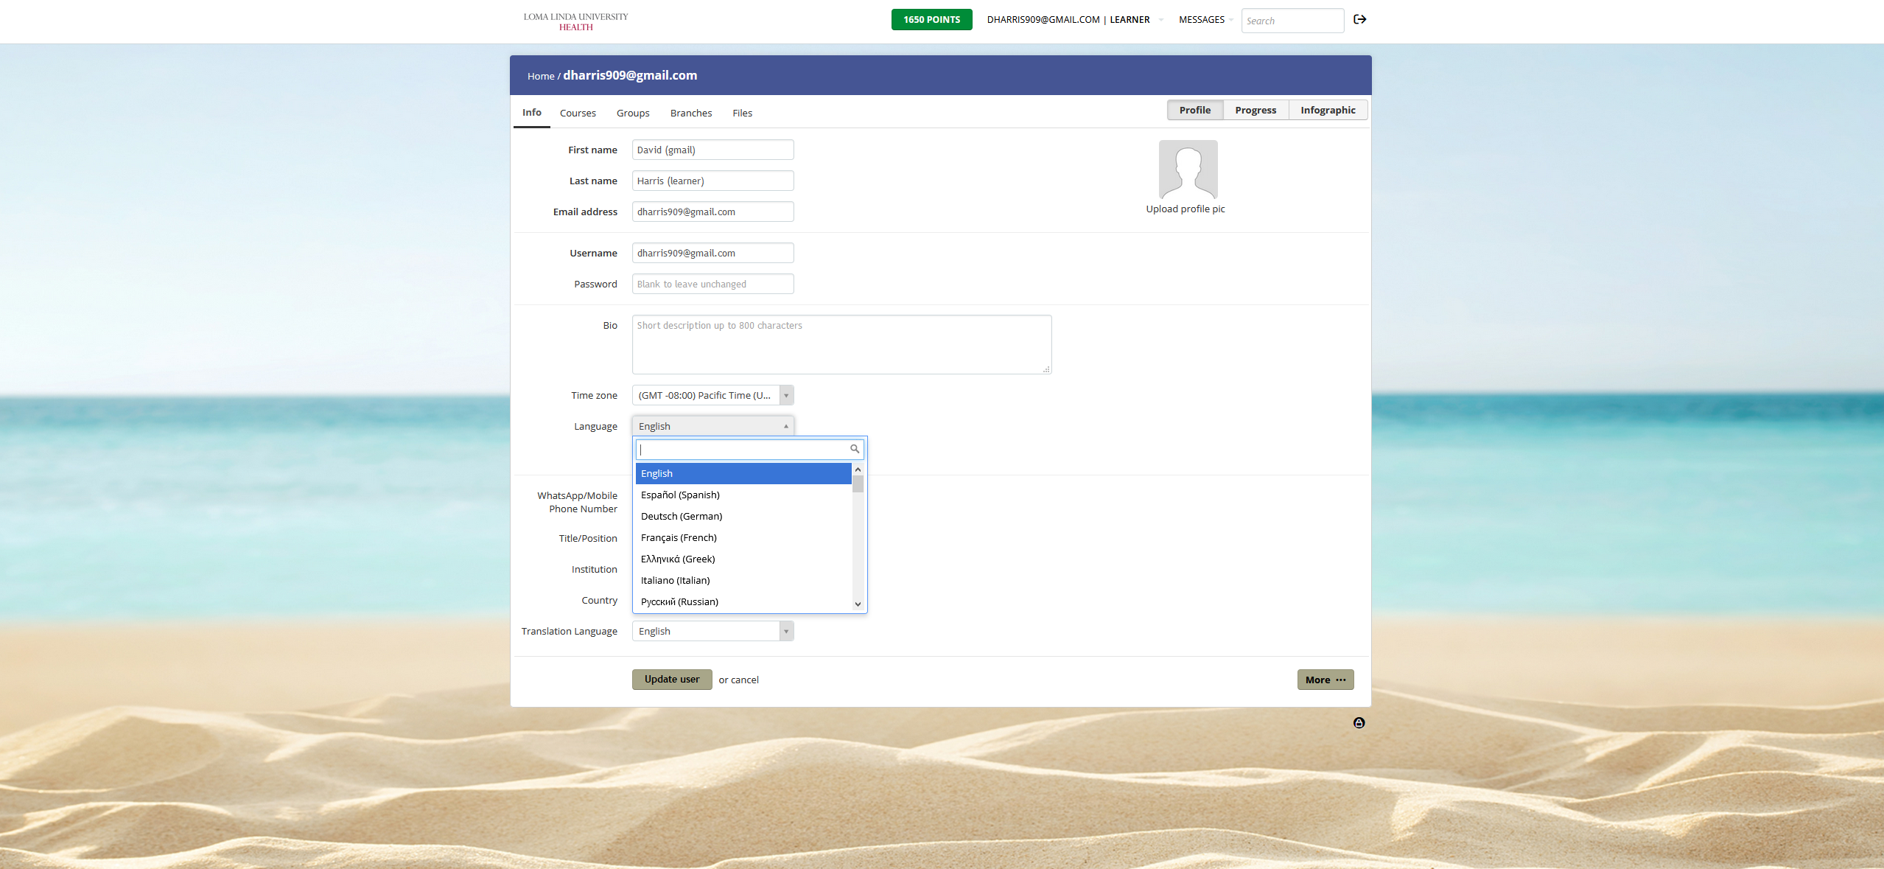
(1) Select your preferred language from the dropdown list. (2) Click Update user
1
2

Slide 17
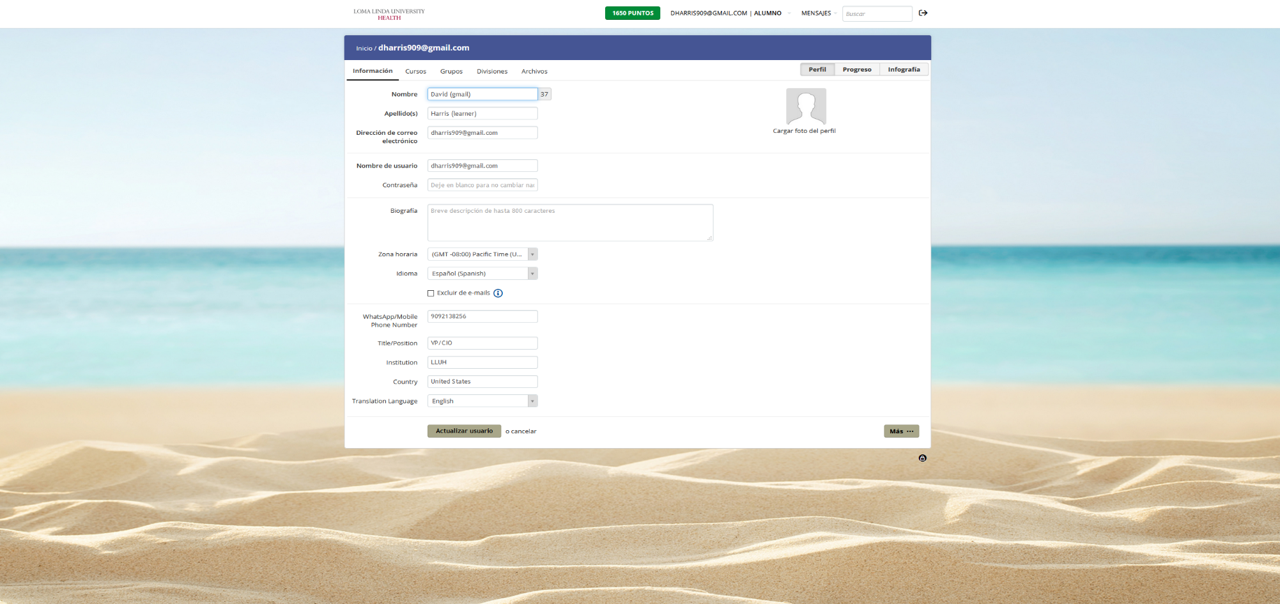
The portal will immediately be translated into the selected language.

Slide 18
4. For access on-the-go, download the Talent LMS App to your smart device

Slide 19
Get the Talent LMS App for your Smart Device

Slide 20
5. To view and register for courses
You are required to register for each course that you attend. This will enable you to see the content and access the applicable links for the classes.

Slide 21
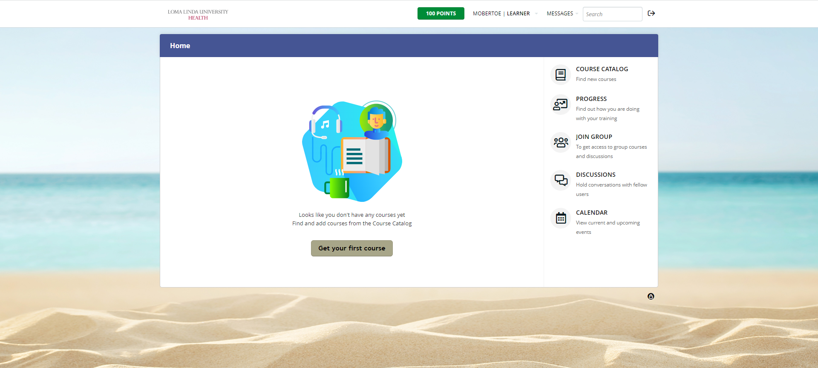
Click on “Course Catalog” to view available courses

Slide 22
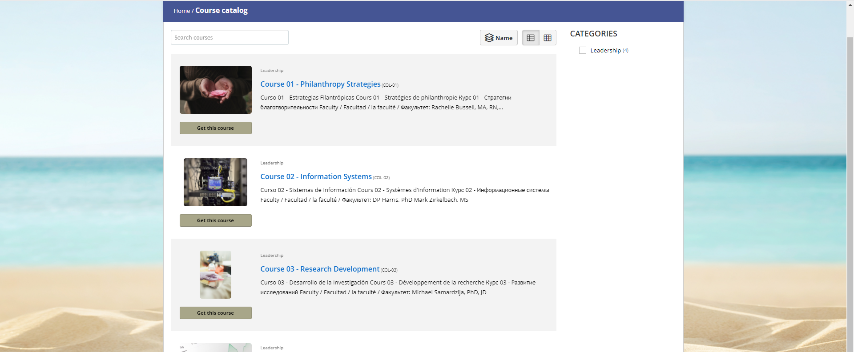
Select “Get this Course” under the Course you are interested in attending
You Must Register for EVERY Course that You Attend

Slide 23
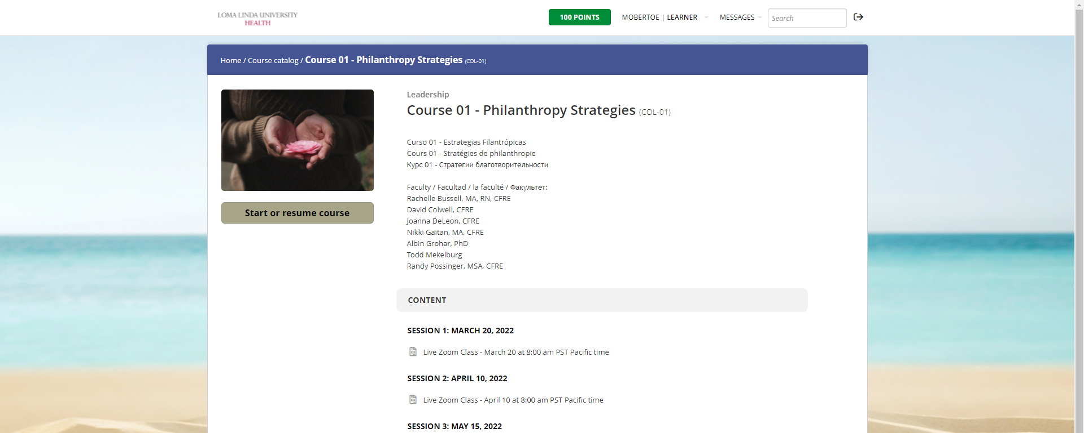
Open the Course to view the content and links to attend live or recorded classes, review materials, and take the post-test

Slide 24
6. To access the Leadership homepage and register for courses directly from the website
You may also view all the course and register for courses directly from the Leadership website.

Slide 25
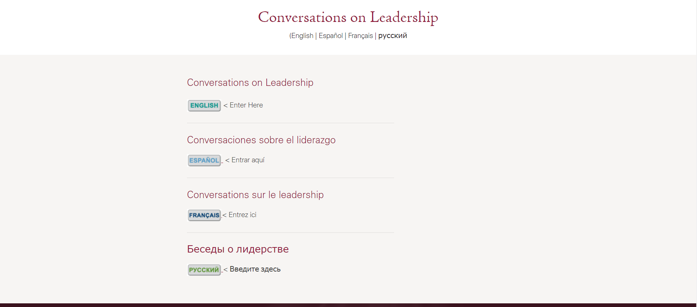
Go to the Leadership Website at: ghi.llu.edu/leadership

Slide 26
Click on your language

Slide 27
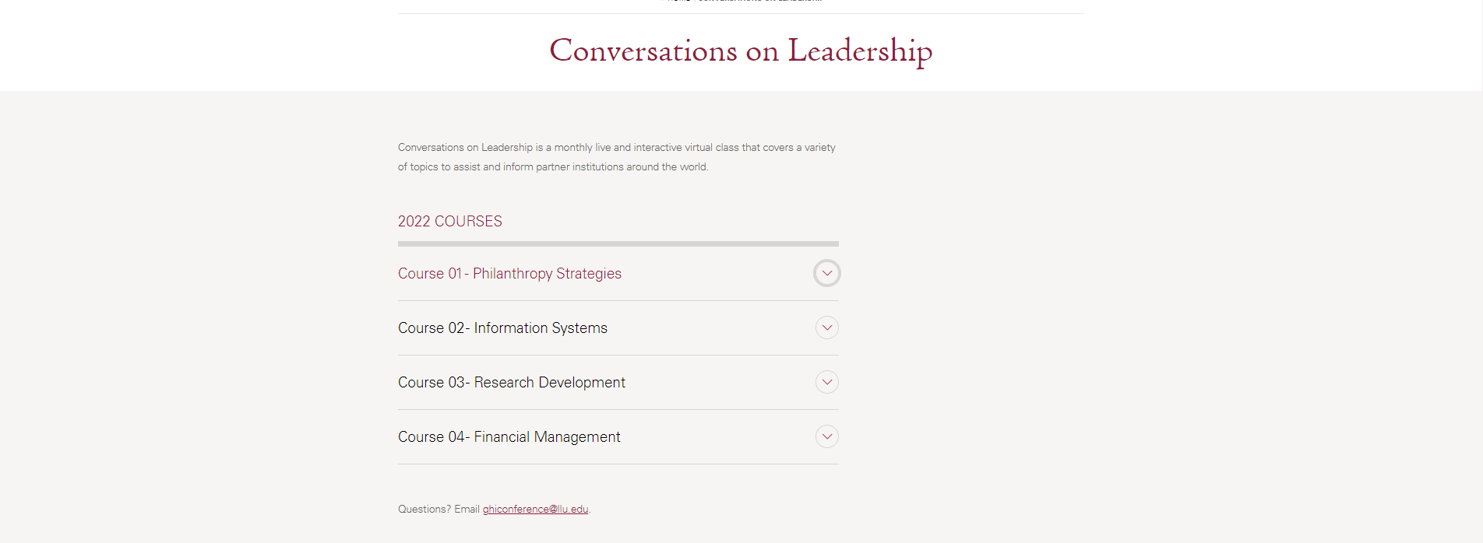
Click on the down ↓ arrow to expand the section

Slide 28
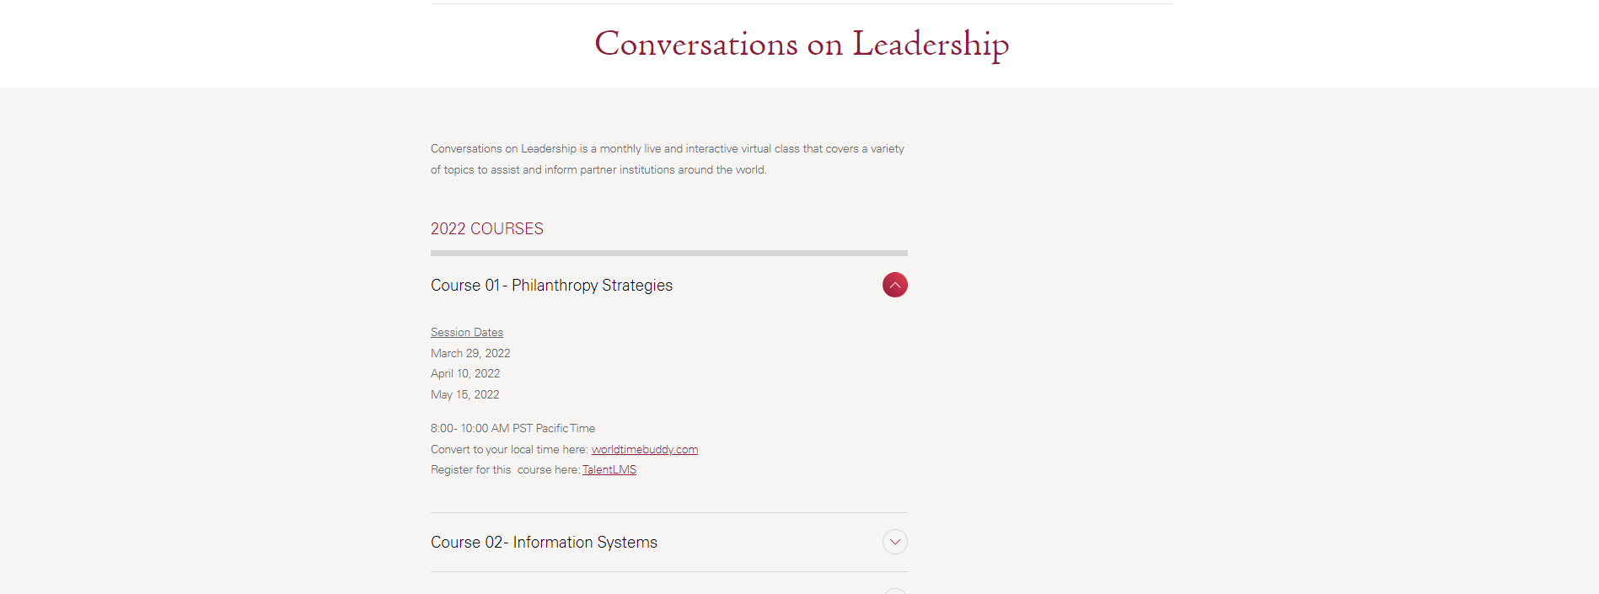
Click on the link to register for the course

Slide 29
To register, click on “Get this course”

Slide 30
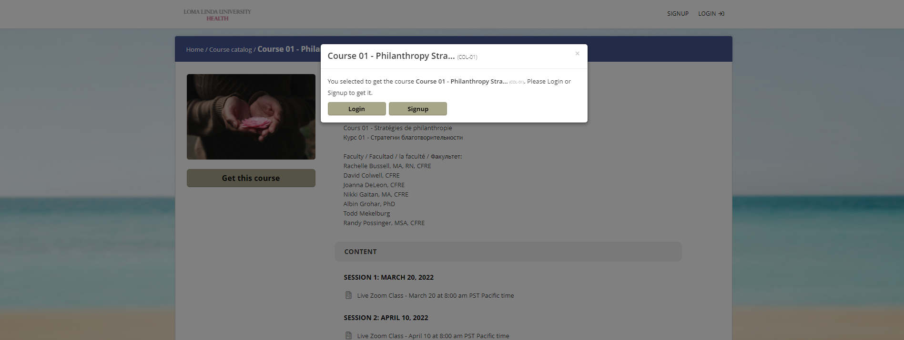
Click on “Login” (users with existing account) or “Signup” (if you do not have an account and need to create one)

Slide 31
7. How to access your TalentLMS Account to view registered courses, upload photo, download certificates, change user information, etc.

Slide 32
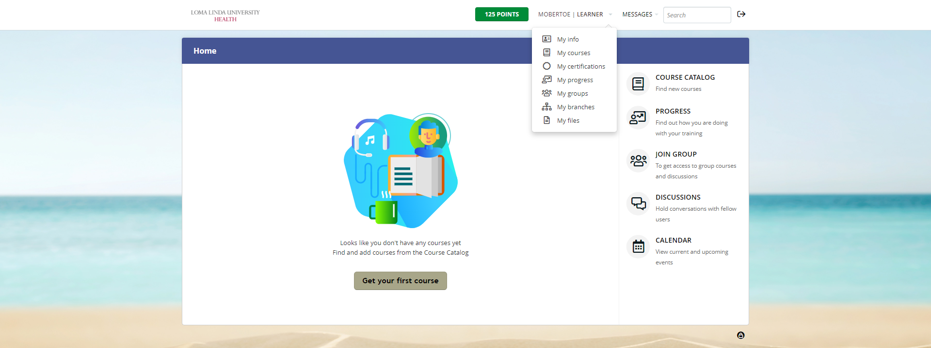
* Go to ghi-lluh.talentlms.com and enter username and password. * At the top of the page, next to your Username Learner, click on down arrow to expand the menu list. * Click on the appropriate menu item.

Slide 33
Click on the message button to view announcements and messages from the class instructors

